Slide 1
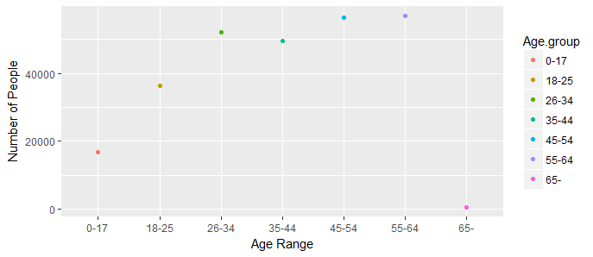
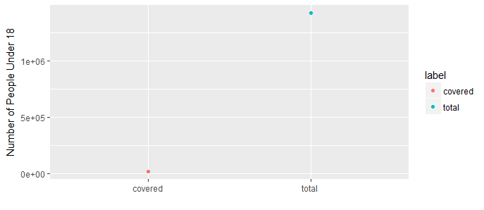
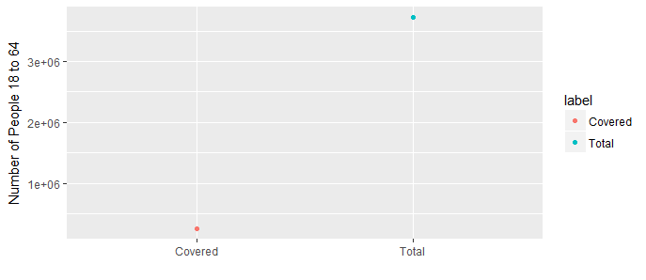
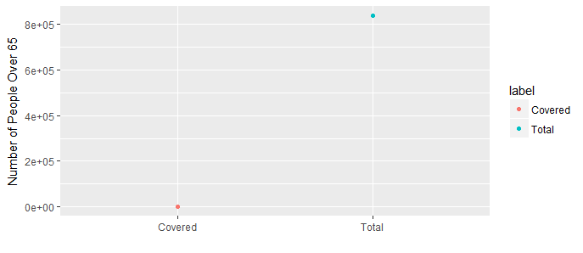
2015 Census Data for those Health Insured in Missouri Based on Age Groups
Amber Vakassi, PharmD Student, and Hayeong Yeom, PharmD Student, and Lauren Staub, PharmD Student, and Paola Vazquez, PharmD Student
St. Louis College of Pharmacy, St. Louis, Missouri
I. Abstract
By using R studio, the 2015 Plan Selections Data is analyzed by filtering and plotting the data specifically for the differences in age groups in Missouri. This is expected to show that certain age groups will have a higher coverage and enrollment rate than those of another age group. By comparing the data to the 2010 census of the population in Missouri, it is expected that the coverage rate is to be well below the total population. Through this comparison, it is beneficial for determining how many individuals are uninsured. Those that are uninsured could be due to either having difficulties being eligible for coverage or difficulties with enrollment. Through further analyzing the data by age groups in Missouri, it would provide a more specific insight into those uninsured in that population. However, the population of 65+ is expected to be excluded from this data because of the majority being covered through Medicare.
II. Introduction
The “2015 Plan Selections by County in the Health Insurance Marketplace” data’s purpose is to analyze individuals based on numerous factors that determine their eligibility and further enrollment in a health care plan. The data was created to determine the number of individuals in the United States that are uninsured by evaluating which individuals are eligible for enrollment, and if they are then whether they have enrolled in a health care plan. This is to reduce the number of individuals that are uninsured in the country. The data population that is chosen to specifically be analyzed, is the differences in those insured between age groups in Missouri.
III. Methods
The “2015 Plan Selections by County in the Health Insurance Marketplace” data includes several different variables including age groups, counties, and state names. The first goal of this project was to specifically analyze the data for the population in the state of Missouri by age. This was done by condensing and filtering the data to only include the state of Missouri. The next aim was to filter the Missouri data for those individuals enrolled in a healthcare plan into various age groups. This had to be achieved by summing the individuals into seven different age groups including 0-17, 18-25, 26-34, 35-44, 45-54, 55-64, and 65-older. A command had to then be created that filtered and summed the population into each of these age groups. The filtered data was then analyzed by forming R commands which would formulate graphs that demonstrate the coverage rates vs. the total population per age group.
Individuals Insured in Missouri
IV. Results
To analyze the “2015 Plan Selections by County in the Health Insurance Marketplace” data set, it was first filtered to include only the data from the state of Missouri, and then it was grouped into different age groups. The sum of the individuals of all age groups that were enrolled in a health insurance plan was then compared to the 2010 population census to determine the percentage of the state population which received health insurance coverage. The resulting graph showed that approximately only 4.5% of the state population was enrolled in a health insurance plan in the year 2015, and that the age groups that had the highest and lowest coverage were the 55-64 and the 0-17 age groups, respectively.
V. Conclusion
The results show that the majority of people enrolled in a health insurance plan were between the ages of 26-64, the highest being in the 55-64 age group, which represents over 55,000 individuals covered. Less than 17,000 individuals between the ages of 0 and 17 were enrolled, accounting for 1.17% of the state population within this age range. Individuals 65 years of age and older were not represented in the results, because they received coverage through Medicare. This project shows that there was a large gap between the total number of people in Missouri and the number of those people that were eligible and enrolled in a health insurance plan in 2015.
VI. Works Cited
“Quick Facts: Missouri.” United States Census Bureau. 2010. Web. https://www.census.gov/quickfacts/MO
2015 Plan Selections by County in the Health Insurance Marketplace [Internet]. ASPE. U.S. Department of Health & Human Services; 2017 [cited 2017Nov27]. Available from: https://aspe.hhs.gov/basic-report/2015-plan-selections-county-health-insurance-marketplace
This graph shows the number of individuals who are enrolled in a healthcare plan. Enrollment increases as the age groups increase, until it reaches the age of 65 and more. The age group of 65 and more has the least amount number of people who are enrolled in a plan because most are eligible and enrolled in Medicare. When compared to the total population in Missouri from the 2010 census, the percentage of those who are covered is about 4.5 %. The new object called sums was created which is the sum of the age ranges. Then to plot the graph, the command ggplot was used. The aes ( x = Age.group, y = total) is to set how the variables will be mapped on the graph. The geom_point () is used to draw the points in the graph and the command “labs” is used to label x and y axis.
Comparison of Coverage vs. Total Population Within Age Groups
A
B
A- This graph is comparing the number of people who are covered versus the total population within the age range of 0 to 18. The amount of people covered is 16,753 and the population is 1,425,365, which is about 1.17 % of the population in this age range.
B- This graph is comparing the number of people who are covered versus the total population within the age range from 18-64. The number of people covered is 251,536 and the population is 3,725,112, which is about 6.75 % of the population in this age range.
C- This graph is comparing the numbers of people who are covered versus the total population within the age range of 65 years and older. The number of people covered is 502 and the population is 838,450, which is about 0.06% of the population in this age range.
C

Slide 2
Staub – Formulating the R commands and graphs
Vakassi – Abstract, Introduction, & Methods
Vazquez – Results & Conclusion
Yeom – Descriptions for the graphs
All – editing and assembling the poster

